Slide 1
Airline Reservation Database Design
Yuxin Shen
Yueming Zhang
Haozhong Duan

Slide 2
database purpose
1. Maintain the data used to search all airline flights information
2. Maintain the purchasing records of customers
3. Browse all users’ information and travel history by administrators
4. Designed for a travel agent use

Slide 3
Design decisions
1. Design User entity as parent entity, Administrator and Customer as two child entities
2. Use Ticket entity to maintain all information that customers need
3. Create FlightStatus entity for administrators to update
4. Add Direction entity to specify the flight for each day
5. Create Passenger entity because customers may book tickets for themselves or other people as well.

Slide 4
Problems solved
Q: Seat is defined by the combination of SeatNumber and AirplaneID.
A: We can create a surrogate key called SeatID for the Seat table and make the original primary keys SeatNumber and AirPlaneID become non-key columns.
1. How to Refer to composite primary key

Slide 5
Problems solved
Q: In the Direction entity, how can we refer to the Airport entity twice?
A: We create two particular entities for arrival and departure airports.
2. How to design airport entity

Slide 6
Problems solved
Q: We have a lot of cost but how can we make profit?
A: For each order, we charge 3% of the ticket price as service fee.
3. How to benefit

Slide 7
Entity relationship diagram

Slide 8
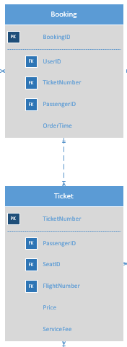
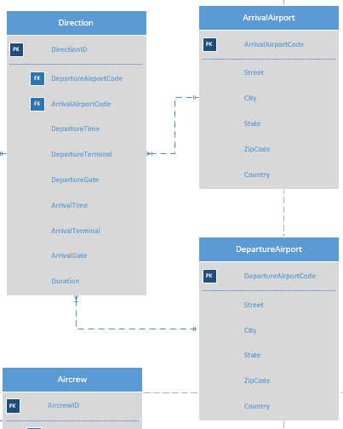
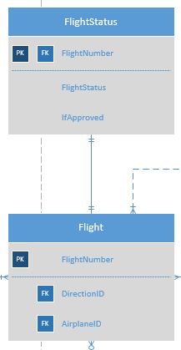
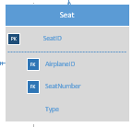
Core erd
The process of booking tickets
Each flight has their status
Seat needs to be defined by AirplaneID and SeatNumber
Direction and airport

Slide 9
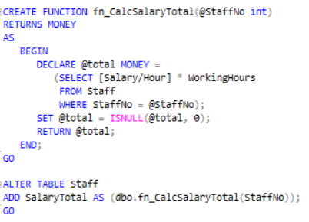
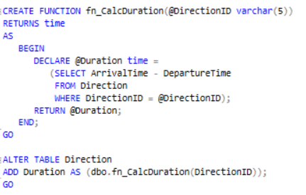
Core code
1. Computed column
calculate staff salary
calculate flight duration

Slide 10
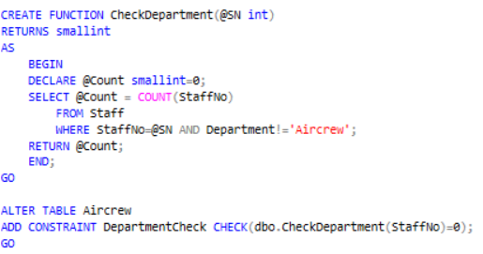
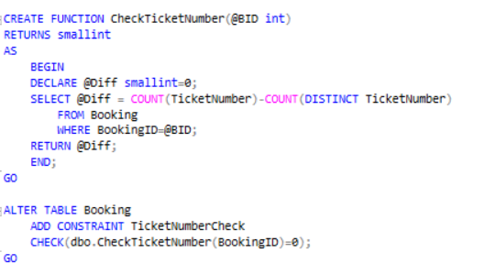
Core code
2. Check constraint
check aircrew department
check if ticket was ordered before

Slide 11
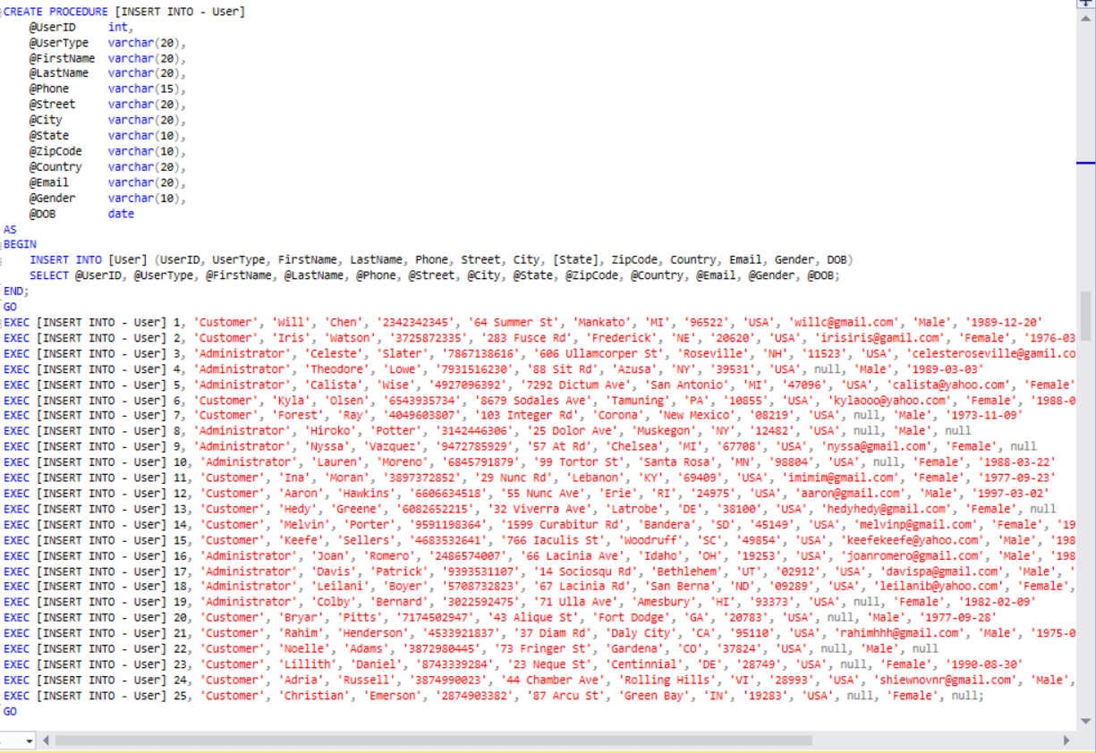
Core code
3. Procedure used to insert values

Slide 12
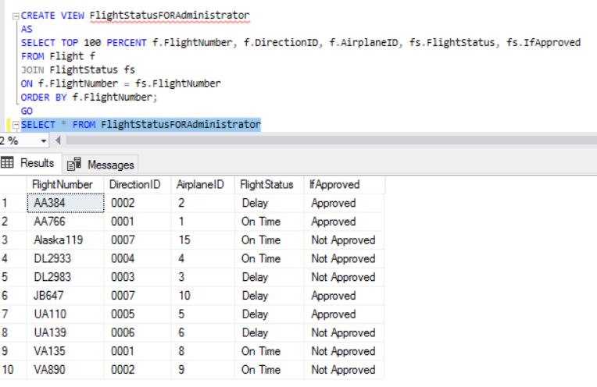
Views
This view is for administrators to check flight status and whether the modify to status is approved or not.

Slide 13
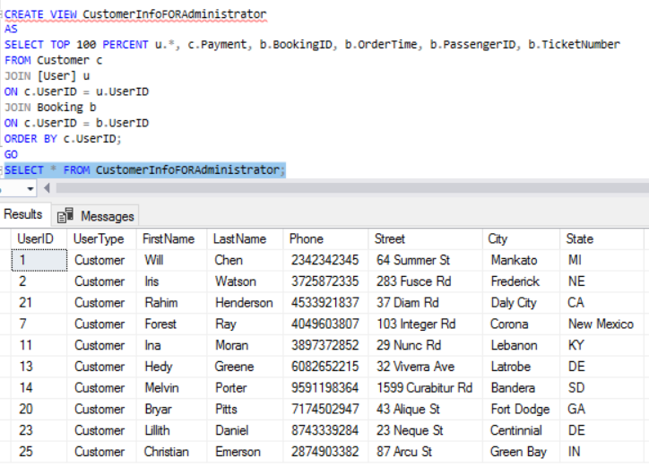
Views
This view is for administrators to manage customers’ information.

Slide 14
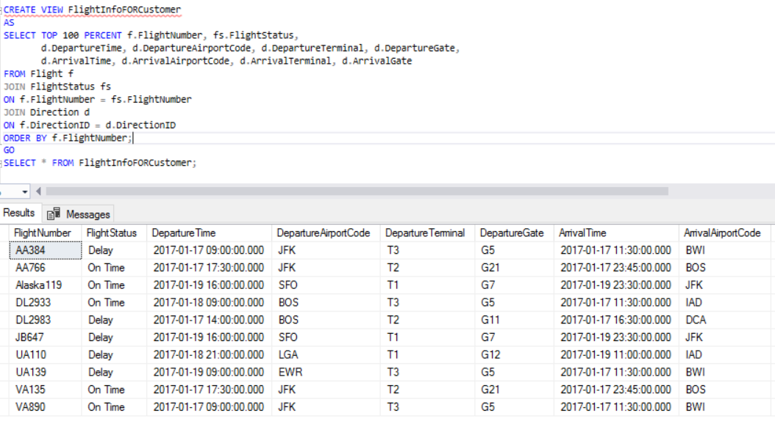
Views
This view is for customers who want to see the detail information of their flights.

Slide 15
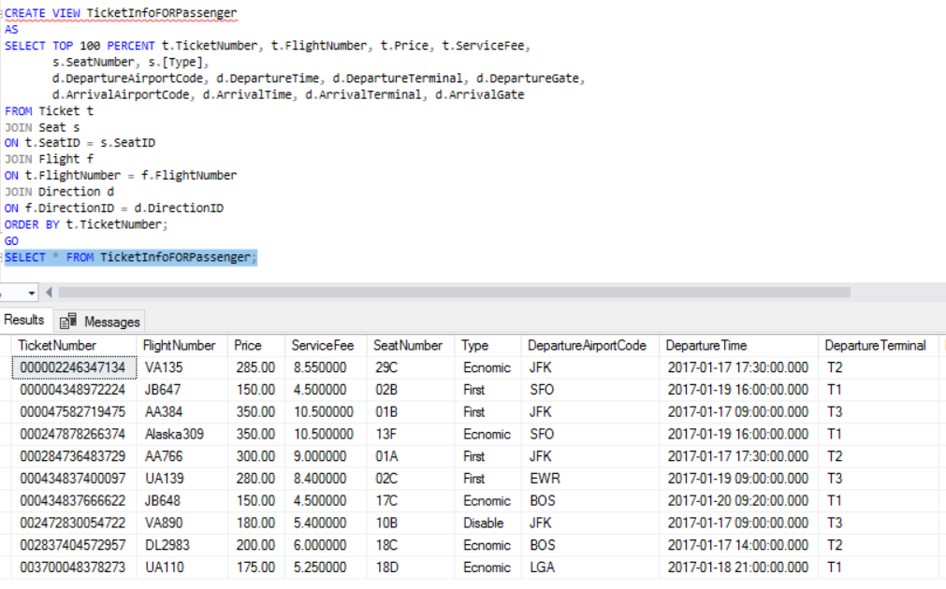
Views
This view is a ticket information for passengers.

Slide 16
reports
The amount of air routes flew by each airline company.

Slide 17
reports
Top popular air routes for this year.

Slide 18
reports
Annual summary on cost and profit.

Slide 19
Future improvement
1. Data collection
2. More functions for administrators
3. More business constraints

